Slide 1
CS5112: Algorithms and Data Structures for Applications
Surprising hashing applications
Ramin Zabih
Some content from: Wikipedia

Slide 2
Administrivia
A duck problem will be on the final exam
But lower bounds will not be, since it’s not core
Extra office hours on Wednesday if needed?

Slide 3
Lecture outline
String search with hashing
Distributed hash tables
Chord and skiplists
Locality sensitive hashing

Slide 4
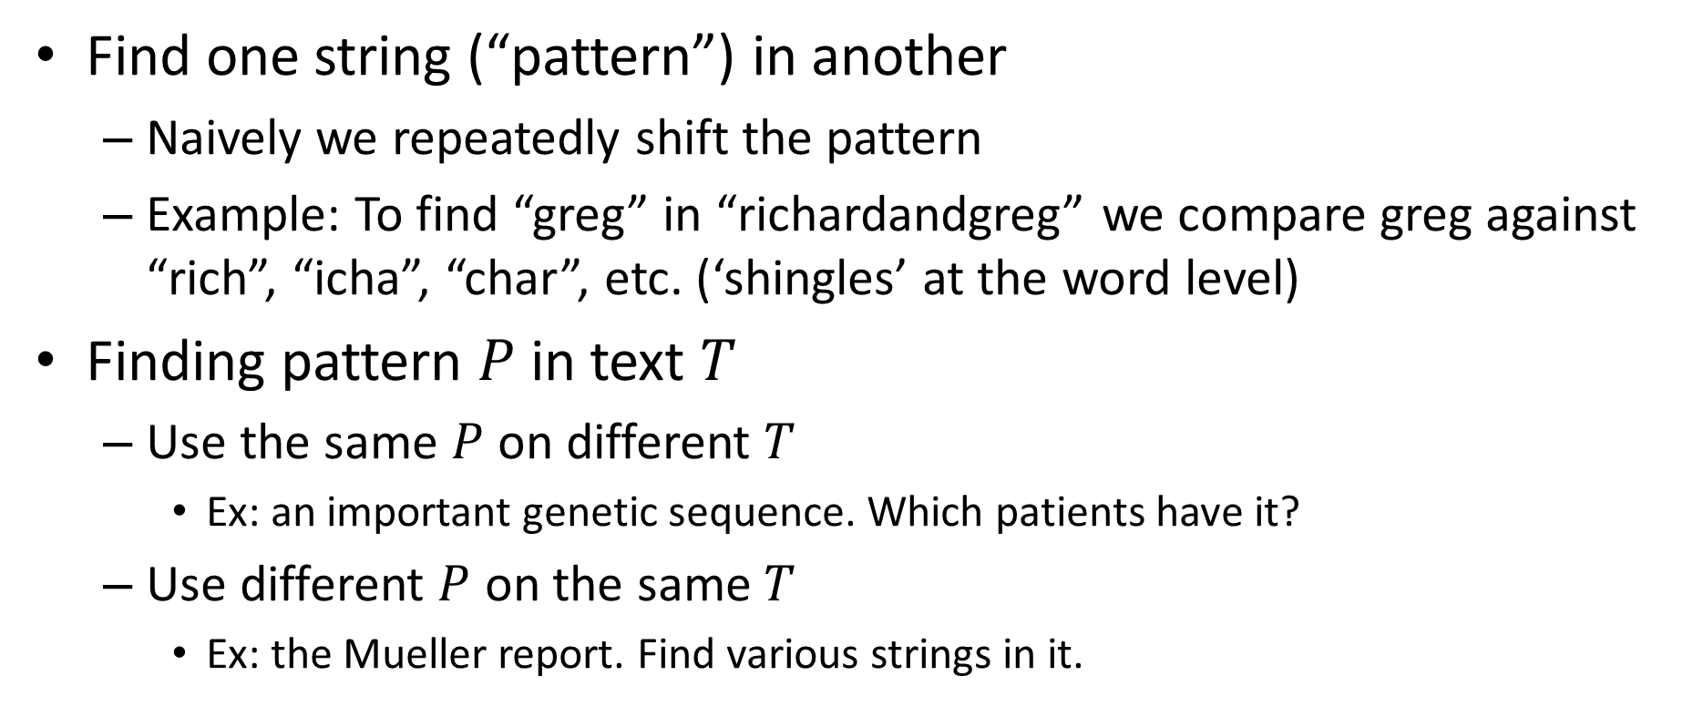
String search
Find one string (“pattern”) in another
Naively we repeatedly shift the pattern
Example: To find “greg” in “richardandgreg” we compare greg against “rich”, “icha”, “char”, etc. (‘shingles’ at the word level)
Finding pattern $P$in text $T$
Use the same $P$ on different $T$
Ex: an important genetic sequence. Which patients have it?
Use different $P$ on the same $T$
Ex: the Mueller report. Find various strings in it.

Slide 5
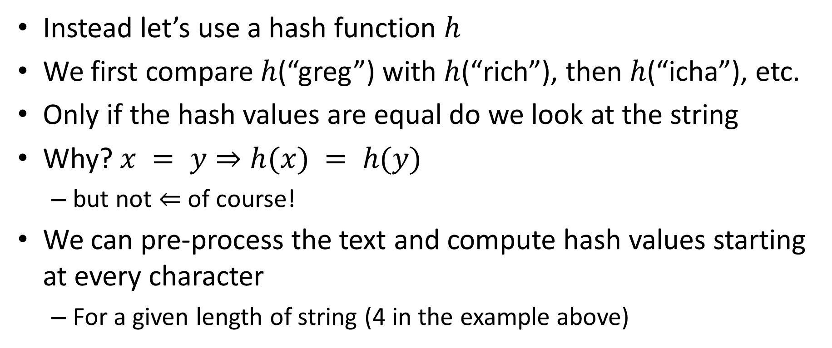
Rabin-Karp string search
Instead let’s use a hash function $h$
We first compare $h$(“greg”) with $h$(“rich”), then $h$(“icha”), etc.
Only if the hash values are equal do we look at the string
Why? $x = y⇒h(x) = h(y)$
but not $⇐$ of course!
We can pre-process the text and compute hash values starting at every character
For a given length of string (4 in the example above)

Slide 6
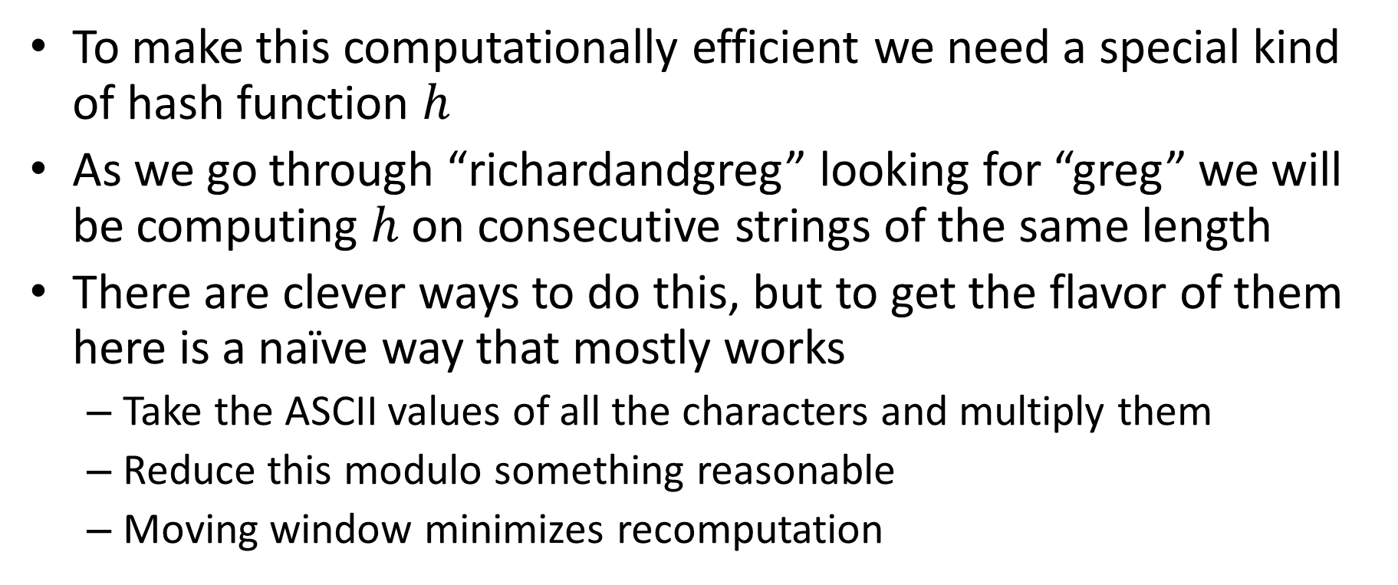
Rolling hash functions
To make this computationally efficient we need a special kind of hash function $h$
As we go through “richardandgreg” looking for “greg” we will be computing $h$ on consecutive strings of the same length
There are clever ways to do this, but to get the flavor of them here is a naïve way that mostly works
Take the ASCII values of all the characters and multiply them
Reduce this modulo something reasonable
Moving window minimizes recomputation

Slide 7
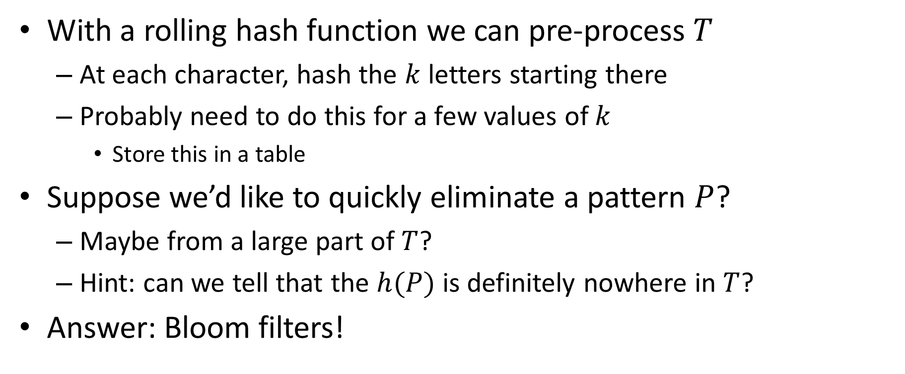
Applying Rabin-Karp
With a rolling hash function we can pre-process $T$
At each character, hash the $k$letters starting there
Probably need to do this for a few values of $k$
Store this in a table
Suppose we’d like to quickly eliminate a pattern $P$?
Maybe from a large part of $T$?
Hint: can we tell that the $h(P)$ is definitely nowhere in $T$?
Answer: Bloom filters!

Slide 8
Distributed hash tables (DHT)
BitTorrent, etc.
Given a file name and its data, store/retrieve it in a network
Compute the hash of the file name
This maps to a particular server, which holds the file
Sounds good! Until the file you want is on a machine that is not responding…
But is this a real issue? Aren’t computers pretty reliable?

Slide 9
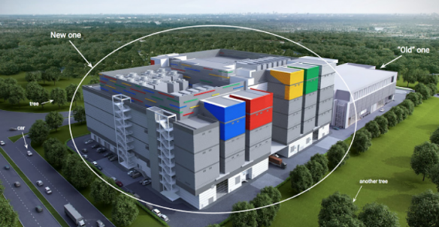
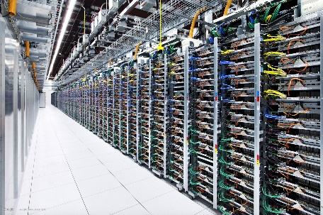
Google datacenter numbers (2008)
In each cluster's first year, it's typical that:
1,000 individual machine failures will occur;
thousands of hard drive failures will occur;
one power distribution unit will fail, bringing down 500 to 1,000 machines for about 6 hours;
20 racks will fail, each time causing 40 to 80 machines to vanish from the network;
5 racks will "go wonky," with half their network packets missing in action;
The cluster will have to be rewired once, affecting 5 percent of the machines at any given moment over a 2-day span.
About a 50 percent chance that the cluster will overheat, taking down most of the servers in less than 5 minutes and taking 1 to 2 days to recover.
Jeff Dean, “Google spotlights data center inner workings”, CNET May 2008

Slide 10
From filename to processor
Typically the result of a hash function is a large number
SHA-1 produces 160 bits (not secure!)
Map into servers with modular arithmetic
Recall: 4 + 7 = 1 (mod 10)
mod with powers of 2 is just the low-order bits
How do we handle a server crashing or rejoining??
Simplest example: we mapped our files to 2 servers
Half hashed to bucket #0 and half to bucket #1
What do we do when one server crashes?

Slide 11
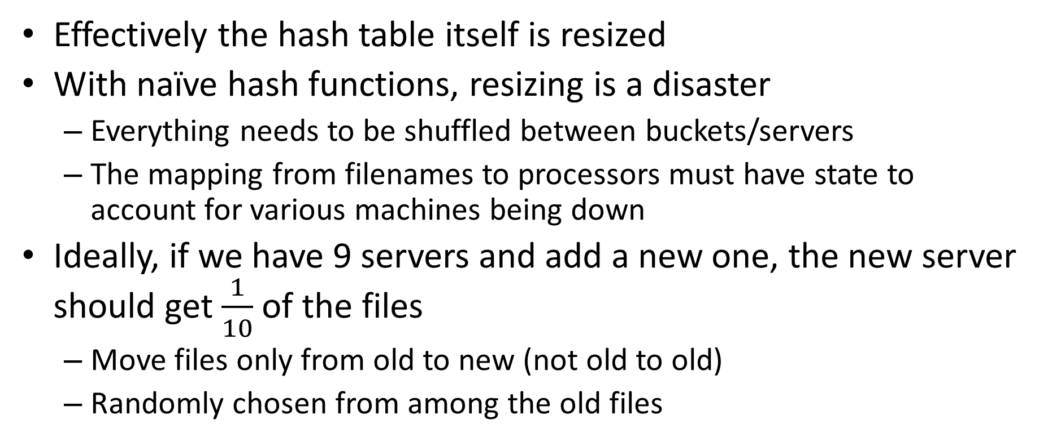
Consistent hashing
Effectively the hash table itself is resized
With naïve hash functions, resizing is a disaster
Everything needs to be shuffled between buckets/servers
The mapping from filenames to processors must have state to account for various machines being down
Ideally, if we have 9 servers and add a new one, the new server should get $\frac{1}{10}$ of the files
Move files only from old to new (not old to old)
Randomly chosen from among the old files

Slide 12
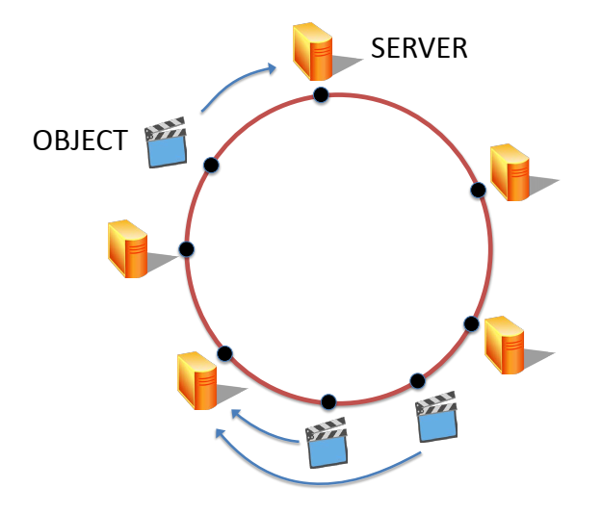
Hashing into the circle
Let’s convert the output of our hash function into a circle
For example, using the low-order 8 bits of SHA-1
We map both servers and data onto the circle
For a server, hash of IP address or something similar
Data is stored in the “next” server on the circle
By convention we will move clockwise
Figure from Maggs, Bruce M.; Sitaraman, Ramesh K. (July 2015), "Algorithmic nuggets in content delivery" (PDF), SIGCOMM Computer Communication Review, New York, NY, USA,45 (3): 52–66

Slide 13
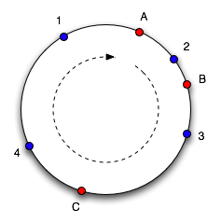
Example of consistent hashing
Data 1,2,3,4 stored on computers A,B,C
Servers->data (good quiz/exam question):
A->1,4
B->2
C->3
If C crashes, we just move 3 to A
Shift data clockwise
Key point: nothing else moves!
Diagram taken from Tom White based on original article

Slide 14
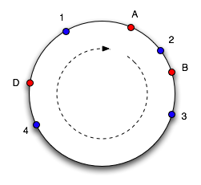
Gracefully adding a server
Add server D after C crashes
Takes 3,4 from A
Servers->data:
A->1
B->2
D->3,4
This is a lot faster!
Naively, going from 3 to 4 servers moves 75% of data
With consistent hashing we move 25% of data
Advantage gets even larger for more servers
Diagram taken from Tom White based on original article

Slide 15
Improving consistent hashing
Need a uniform hash function, lots of them aren’t
Note that the data still needs to move after a crash
Store the servers in a BST to efficiently find successor
This requires global knowledge about the servers
Global knowledge is a key weakness
Popular objects are a challenge

Slide 16
Handling popular objects
Each popular object can have its own hash function
Basically, its view of the unit circle
Ensures that you are very unlikely to have 2 popular objects share the same server

Slide 17
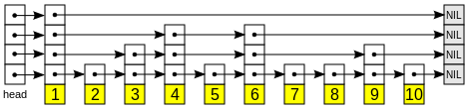
Skip lists
Can we find an element in a sorted list quickly?
Hierarchy of ‘express lanes’, randomly generated
Lookup goes in row-major order
If we find something greater, backtrack and drop down a level
Source

Slide 18
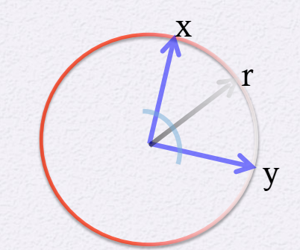
Other important LSH families
We looked at Hamming distance via random subset projection
Jacard similarity via min hash
Hash functions are random permutations
Compute the minimum value of a subset under a permutation
Angle similarity via projection onto random vector

